Slide 1

MLOps: When DevOps meets
Machine Learning
Andrea Afify (813466), Emanuele Marnati (812503), Alessandro Risaro (825113)
Technological Infrastructures for Data Science

Slide 2
Table of contents
Introduction
Why MLOps?
Three different Setups
MLOps vs DevOps vs Agile
Issues and Challenges
Hands-on Session's Models
Hands-on Overview

Slide 3
MLOps
Aims and Needs

Slide 4
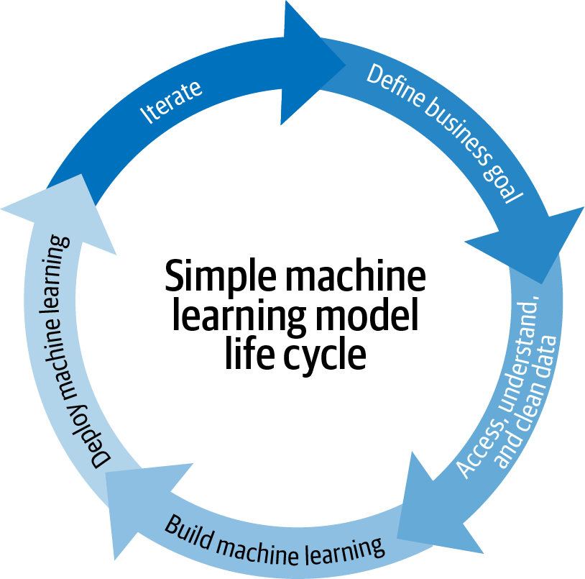
A Short Introduction
When you are looking for machine learning solutions to real problems, you may encounter several difficulties.
As a matter of fact, during the implementation of these models, it is necessary to go through several steps that represent the life cycle of a machine learning model:
Collect and process raw data.
Analyze the data.
Process the data for training.
Construct, train and test the model.
Validate and tune the model.
Deploy and monitor the model.

Slide 5
Why MLOps?
Hopefully, it’s clear just how work-intensive the entire process can
get, especially since it will most likely need to be repeated multiple times.
The entire cycle is time consuming: updating the model on new data patterns and trends, it is a problem which can take up hours of manual labor that can be better spent elsewhere.
Cost Increase: worsening the overall maintenance costs because the costs for deployed machine learning models are added on top of the costs for the software application utilizing the services of the models.

Slide 6
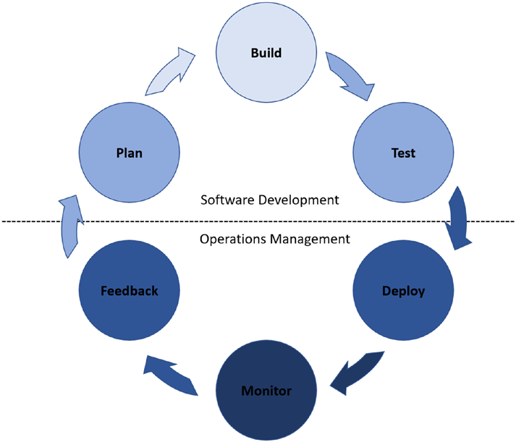
A possible solution: MLOps
MLOps, which can be thought of as the intersection between machine learning and DevOps practices, tries to solve the previous problems.
As a matter of fact, DevOps, or developmental operations, refers to a set of practices that combines the work processes of software developers with those of operational teams to create a common set of practices that functions as a hybrid of the two roles. In this way:
the developmental cycle of software is expedited, and continuous delivery of software products is ensured.
Total costs also go down because maintenance costs are reduced as a result of the increase in efficiency of the workflow in maintaining the software applications.

Slide 7
MLOps: Three different setups
We have three main setups of machine learning solutions:
Manual implementation.
Continuous model delivery.
Continuous integration/continuous delivery of pipelines.

Slide 8

Manual Implementation
Refers to a setup where there are no MLOps principles applied and everything is manually implemented.
The steps discussed above in the creation of a machine learning model are all manually performed.
Software engineering teams must manually integrate the models into the application, and operational teams must help ensure all functionality is preserved along with collecting data and performance metrics of the model.

Slide 9
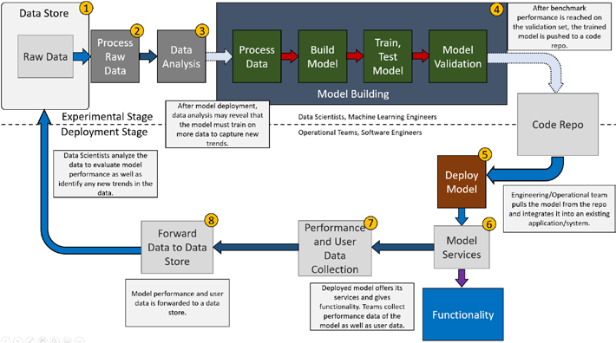
How it works!

Slide 10

Continuous Model Delivery
Here, we see the emergence of pipelines to allow for automation of the machine learning side of the process.
The main feature of this type of setup is that the deployed model has pipelines established to continuously train it on new data, even after deployment.

Slide 11
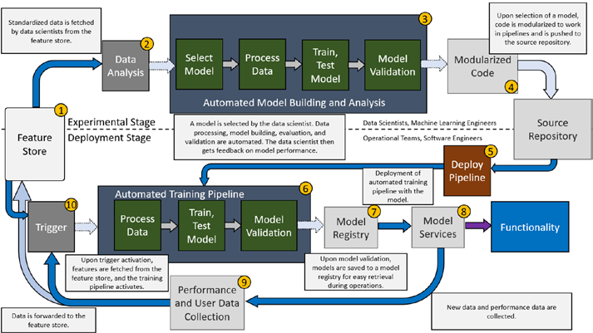
How it works!
Automation of the experimental stage, or the model development stage, also emerges along with modularization of code to allow for further automation in the subsequent steps.
In this setup, continuous delivery refers to expedited development and deployment of new machine learning models.
With the barriers to rapid deployment lifted (the tediousness of manual work in the experimental stage) by automation, models can now be created or updated at a much faster pace.

Slide 12
Continuous Integration & Delivery of Pipeline
It refers to a setup where pipelines in the experimental stage are thoroughly tested in an automated process to make sure all components work as intended.
From there, pipelines are packaged and deployed, where deployment teams deploy the pipeline to a test environment, handle additional testing to ensure both compatibility and functionality, and then deploy it to the production environment.

Slide 13
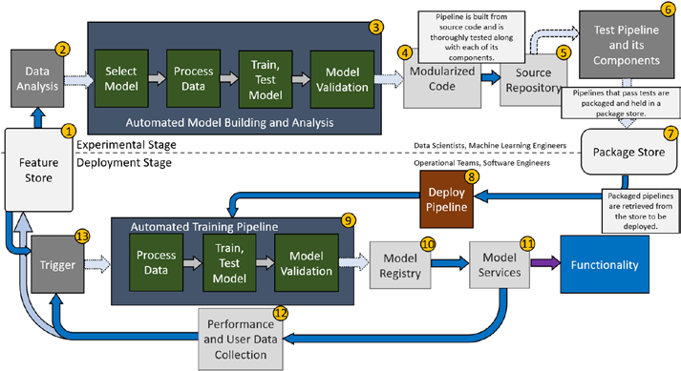
How it works!
In this setup, pipelines can now be created and deployed at a quick pace, allowing for teams to continuously create new pipelines built around the latest in machine learning architectures without any of the resource barriers associated with manual testing and integration.

Slide 14
MLOps vs DevOps vs Agile
Comparison and Issues

Slide 15
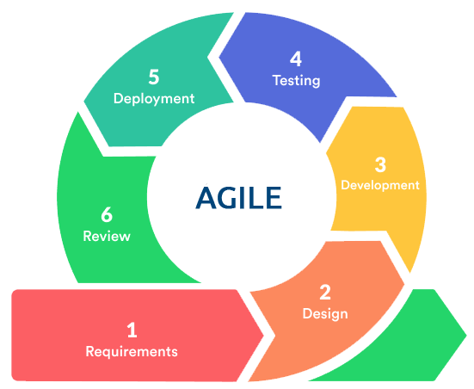
What is Agile methodology?
Agile is an iterative approach to project management and software development that helps teams deliver value to their customers faster and with fewer headaches.
Instead of betting everything on a "big bang" launch, an agile team delivers work in small, but consumable, increments.
Requirements, plans, and results are evaluated continuously so teams have a natural mechanism for responding to change quickly.

Slide 16
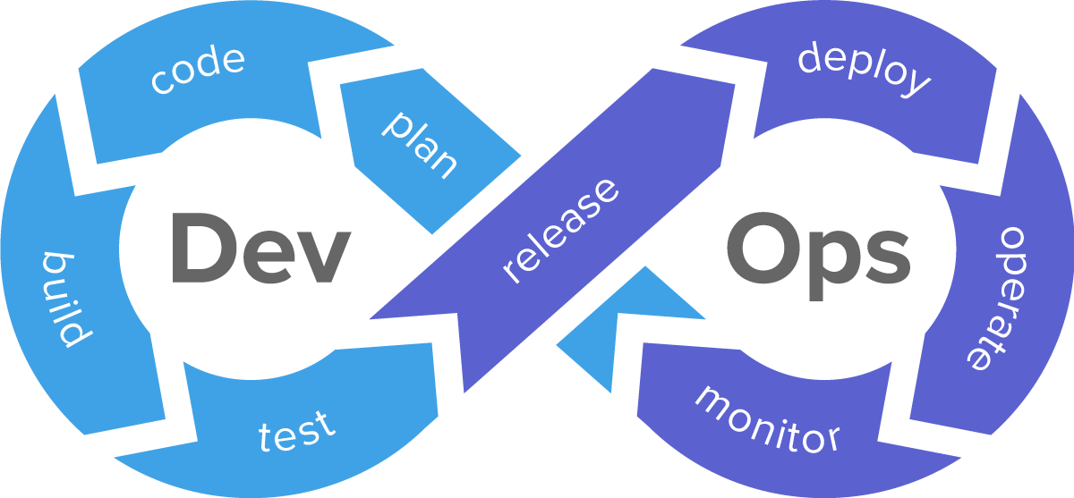
From Agile to DevOPS
DevOps is an approach to software development that enables teams to build, test, and release software faster and more reliably by incorporating agile principles and practices, such as increased automation and improved collaboration between development and operations teams.
Development, testing, and deployment occur in both agile and DevOps. Yet traditional agile stops short of operations, which is an integral part of DevOps

Slide 17

What would happen if we applied DevOps principles to Machine Learning?

Slide 18
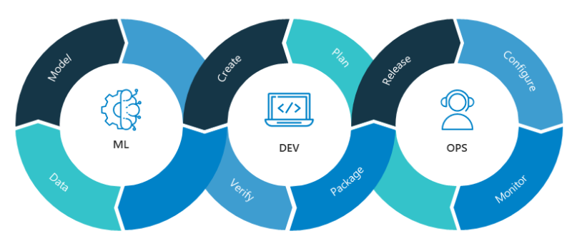
MLOps
MLOps is a set of practices that apply DevOps principles to machine learning problems to ensure the creation of machine learning products that you can verify, trust, and maintain in the long term.
There are many shared elements between DevOps and MLOps such as:
Code and component testing
Automation
Continuous integration of code
Continuous delivery into production
Cross-Team collaboration
Integration of feedbacks loops

Slide 19
MLOps vs DevOps: Main Differences
 | DevOps | MLOps
Goal | Automate software quality assurance checks and feedback loops | Support the Machine Learning Lifecycle with automated quality checks
Componentes | Continuous integration + Continuous Delivery | Continuous training + Continuous Validation
Deployment cycles | Frequent iterations | Long, continuous and resource hungry (re)training cycles
Team composition | SWD + QA Engineer + Devops | Data Scientist + ML Engineer + Data Engineer
Main deliverable | Code, executable | Model, Data, Metadata, Training parameters
Quality assurance | Code Tests | Data and Model Validation

Slide 20

MLOps: Issues and Challenges
The addition of Data and Machine Learning models, which an MLOps process must address compared to a DevOPS process, has caused some issues and challenges :
Model Drift
Data Drift

Slide 21
MODEL DRIFT
A deployed model is based on a definition of what the business case needs. These needs may evolve.
For example, if you were detecting credit card fraud and the business evolved its thinking it will need a rethink or retraining of the model.

Slide 22
DATA DRIFT
This is when you train a model on the demographics of a set of users and now you are observing that the population it is being utilized on doesn’t match the same demographic.
Other examples of data drift is based on change of the data due to seasonality, changes in consumer preferences, the addiction of new products ecc. MLops can listen to these changes and trigger automated retraining of the models

Slide 23
MLOps Models
How to build a fully automated training and deployment pipeline on Azure

Slide 24
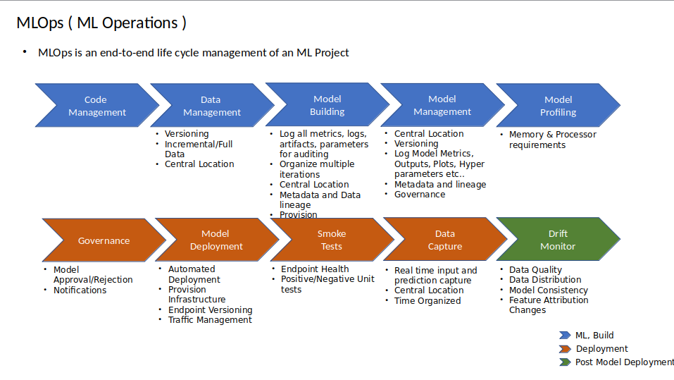
The models of our demo

Slide 25
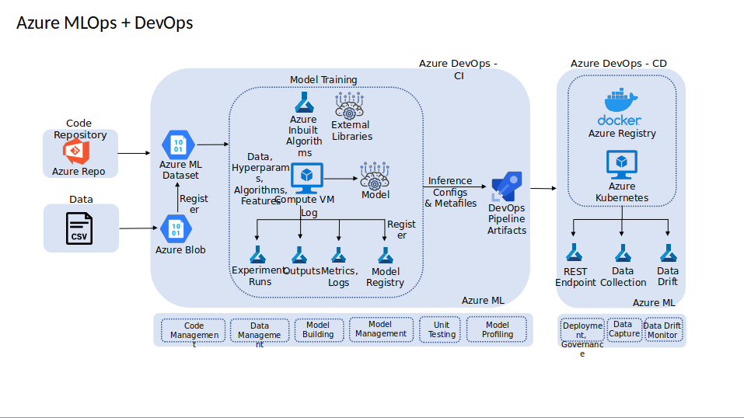
Our Hands-On Flow

Slide 26
Hands-On
AZURE DevOps + MICROSOFT AZURE MACHINE LEARNING STUDIO

Slide 27
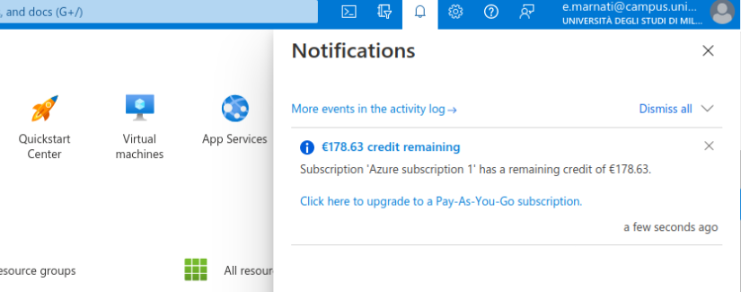

Microsoft Corp kindly gives you 200 $ credit
Monthly free access for basic function on Azure (no Kubernetes or MLFlow + integration)
The credit quickly reduces
Initial Settings

Slide 28
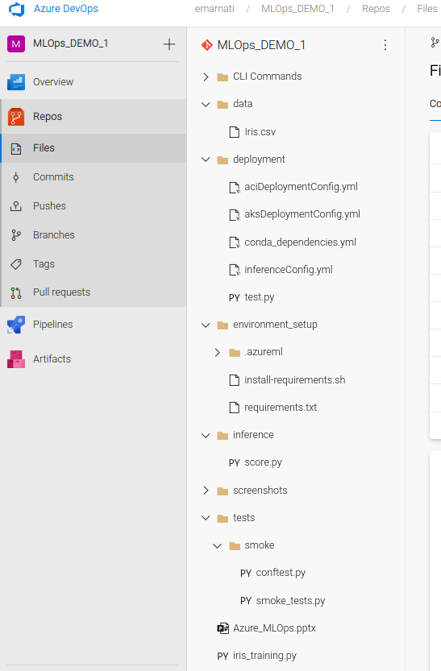

Import some python code from outside Azure
Choose a basic binary classification task (IRIS Dataset)
Simply select a GitHub repo to interact with
This project is static in time and therefore no data drift can be assessed
Many thanks Srijith!
Get some Classification Task: IRIS Database

Slide 29
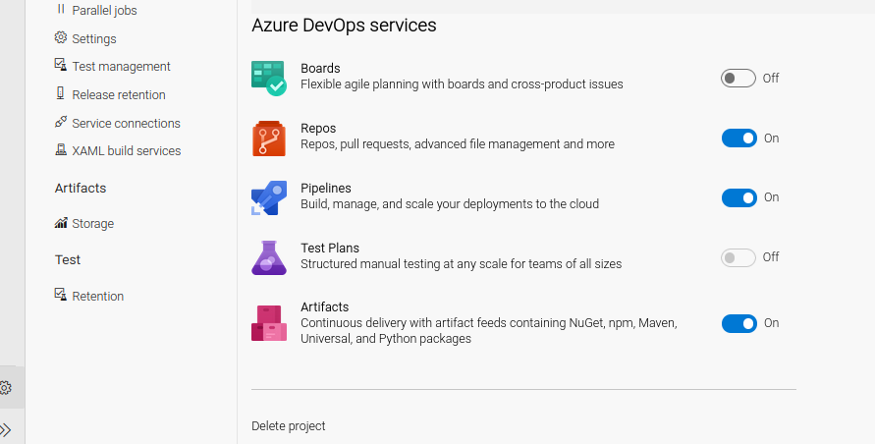
Repos: enable connection between some code outside (you can connect directly with Visual Studio / VSCode)
Pipelines: is the process of connected different phases mainly with Azure CLI (Azure Command Line Interface)
Artifact: will be our ML product, ready to deploy
Select Azure DevOps Services

Slide 30
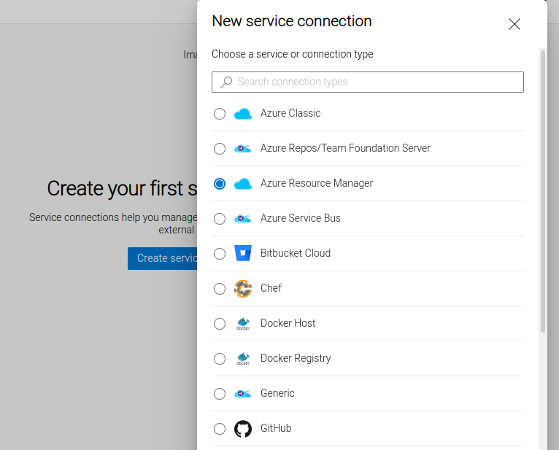
It is important to create a service principle (selecting a resource group)
It will be extensively used into CI pipeline and CD too
Without service principles we will not be able to authenticate our pipeline
Azure Resource Manager

Slide 31
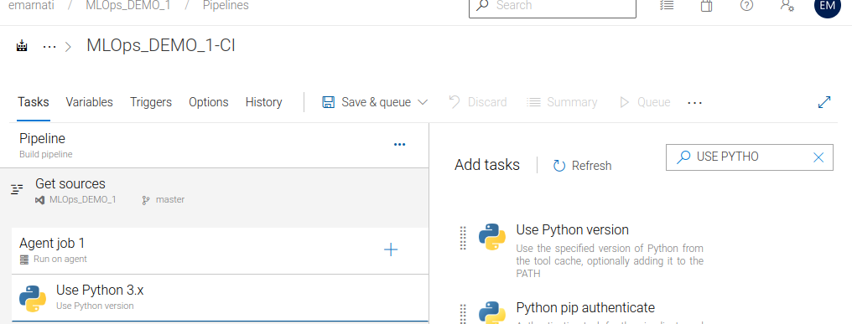
You have different AGENT JOB
The ration is: “The simplest way” so we won’t integrate python anymore just bash and shell
A DevOps person without knowing python will still be able to operate
Start Up with Python Settings

Slide 32
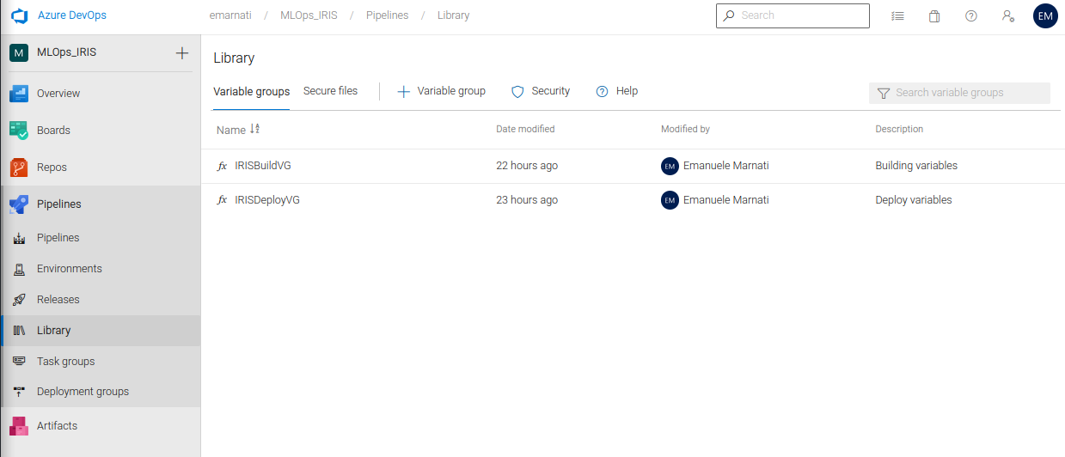
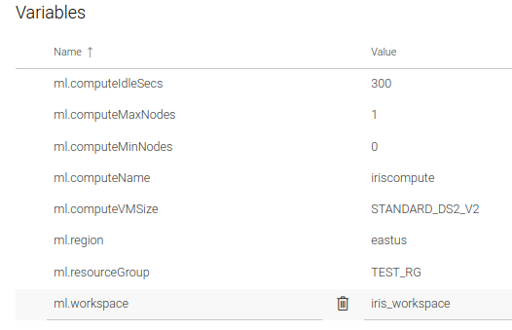
Variables are arguments which are getting passed to the CI pipeline
You can avoid duplication of variables
You can here specify: the compute machine, the vm, the region, the resource group, the workspace name
The Library

Slide 33
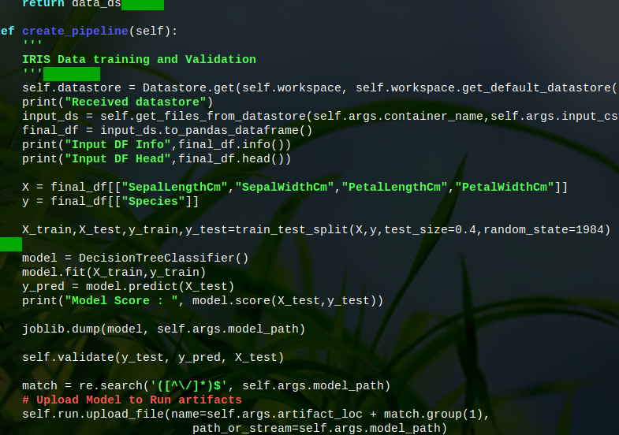
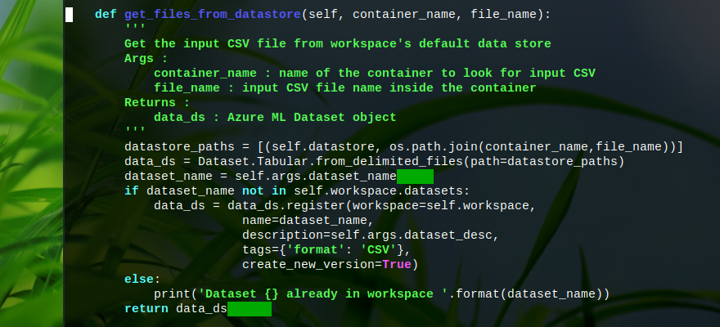
create_pipeline function
get_files_from_datastore function
We use the parameters from Azure (it's all harmoniously integrated)
GitHub Code Overview

Slide 34


Slide 35
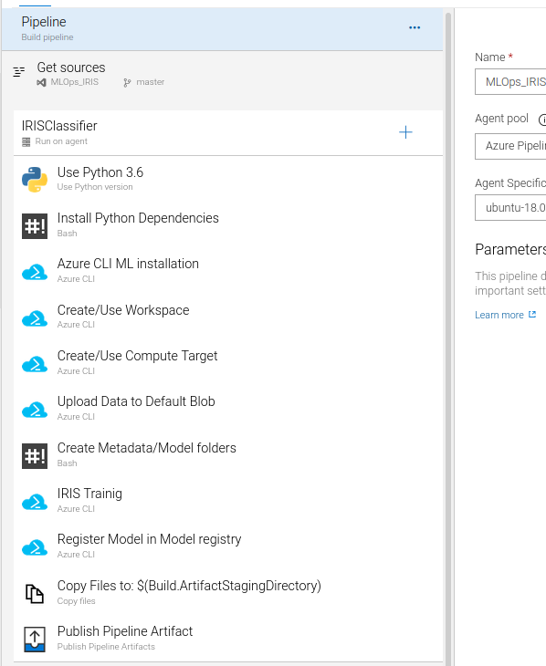
Install the dependencies
Azure CLI ML installation
Create the workspace
Set the compute target machine for the training script
Upload the .csv file into an Azure Blob Storage
Create metadata folder
Execute the script and register the model
Pick the artifact and put it inside the CD pipeline (next phase)
Create metadata folder
Components

Slide 36
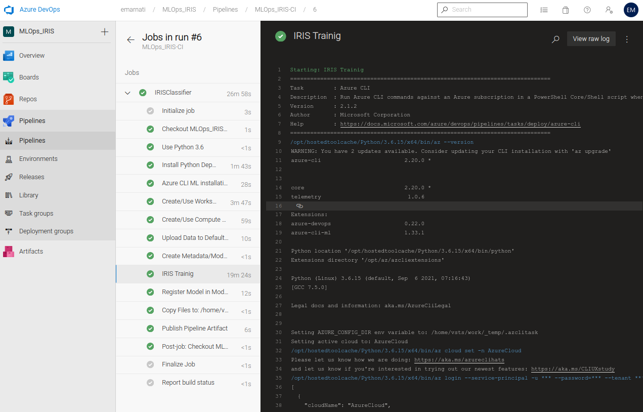
Dig deeper into container Log – LIVE RUNNING

Slide 37
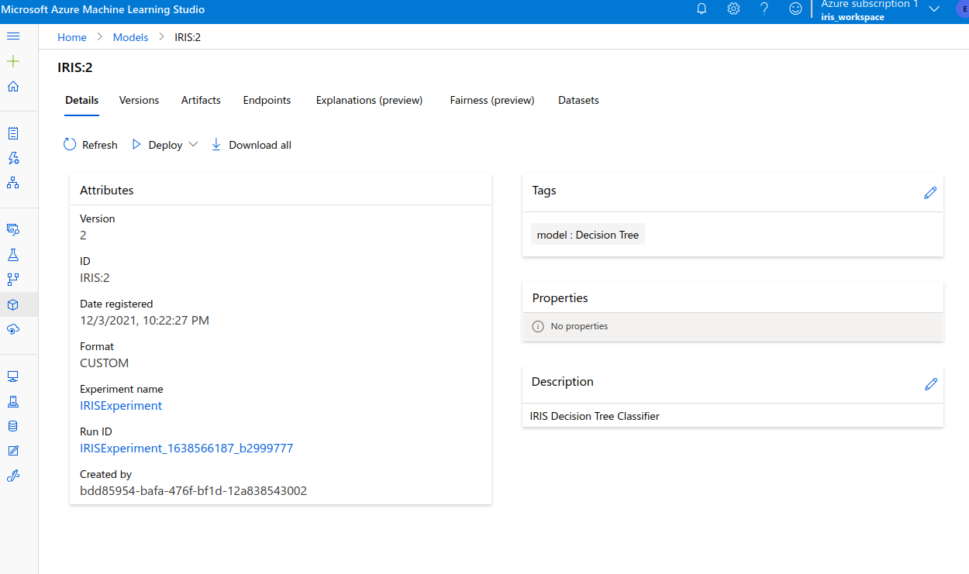
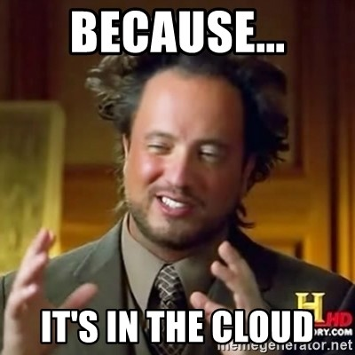
So far we have seen a DevOps environment, but with one click we can switch to the Microsoft Azure Machine Learning Studio environment.
Experiment: is the main component, logical grouping of all your runs (different iterations of your model training)
Where is the ML Experiment?

Slide 38
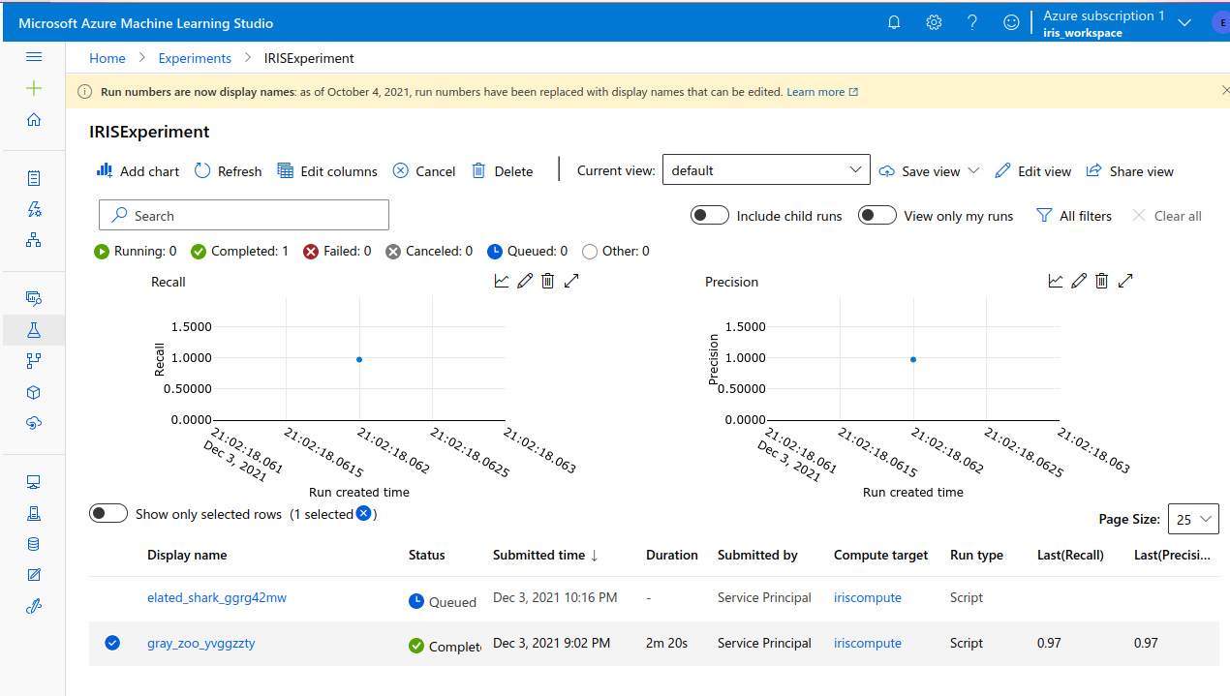
All the metrics are here logged and monitored
You can plot a graph with recall, precision, accuracy
You can confront all these metrics between different runs
Where are the ML Metrics?

Slide 39
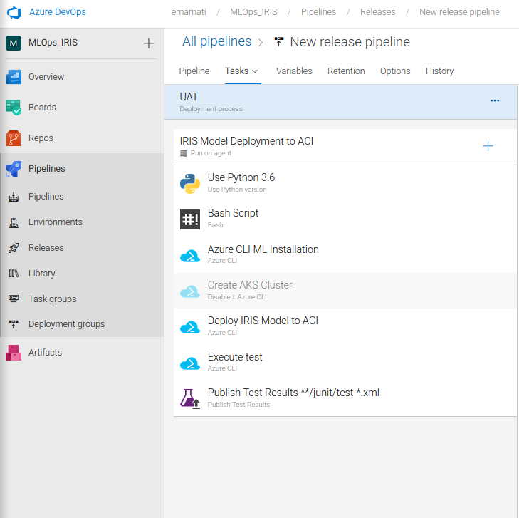
Similar process as with the build part
Some dependencies installation first
We cannot use Azure Kubernetes Service for deploy, so we use Azure Container Registry
Create metadata folder
In production you shouldn’t use Container Registry, is not reliable!
We perform the smoke test and publish its result
Deploy Pipeline - Release

Slide 40
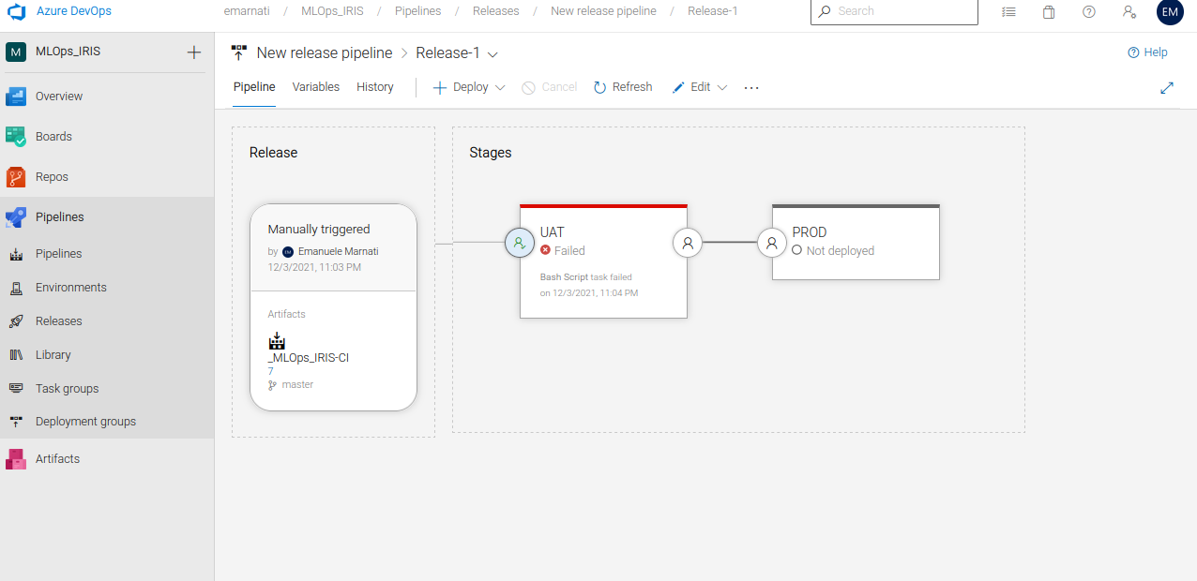
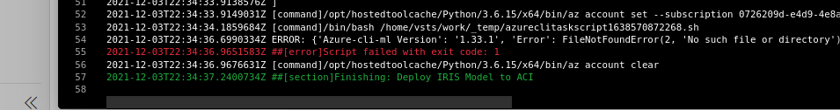
The process is held by Azure CLI Machine Learning extension
We trigger the artifact, test and deploy it
Release Workflow - Testing - Production

Slide 41
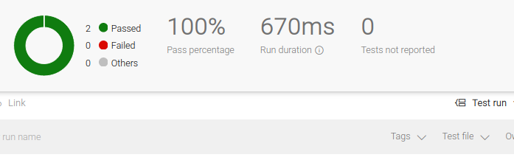
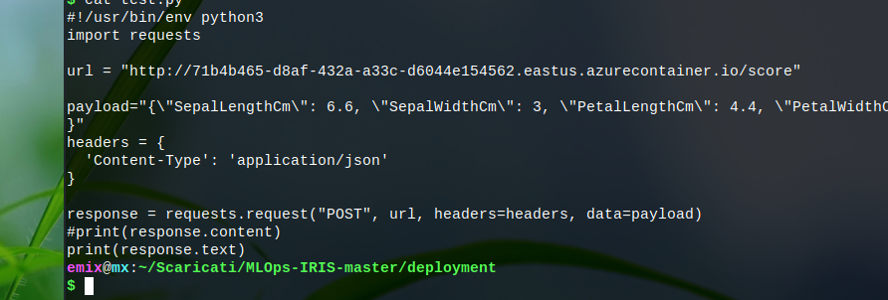
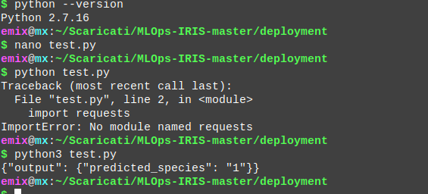
After some tries and effort, the test is okay
With our script connected to the Endpoint we run test.py
The predicted species is “1”
How hands my test?

Slide 42
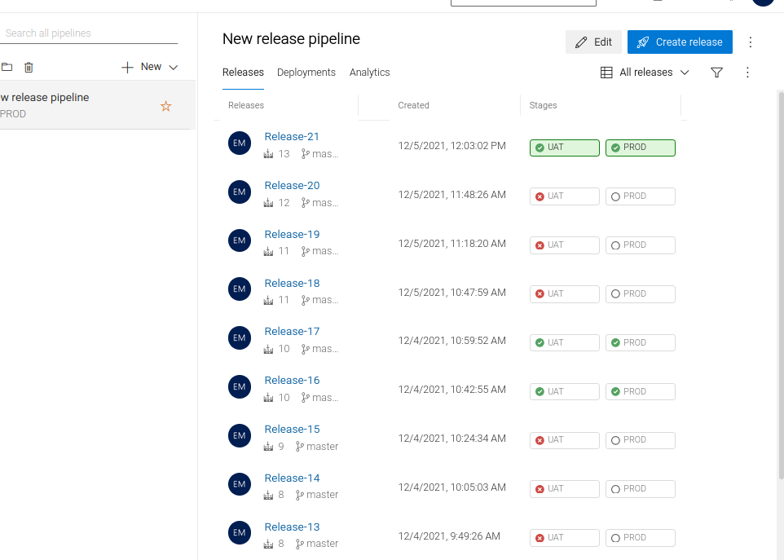

After some troubleshooting we have our accepted release!
Release

Slide 43
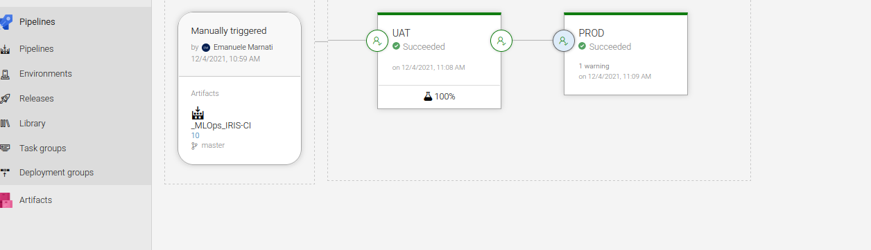
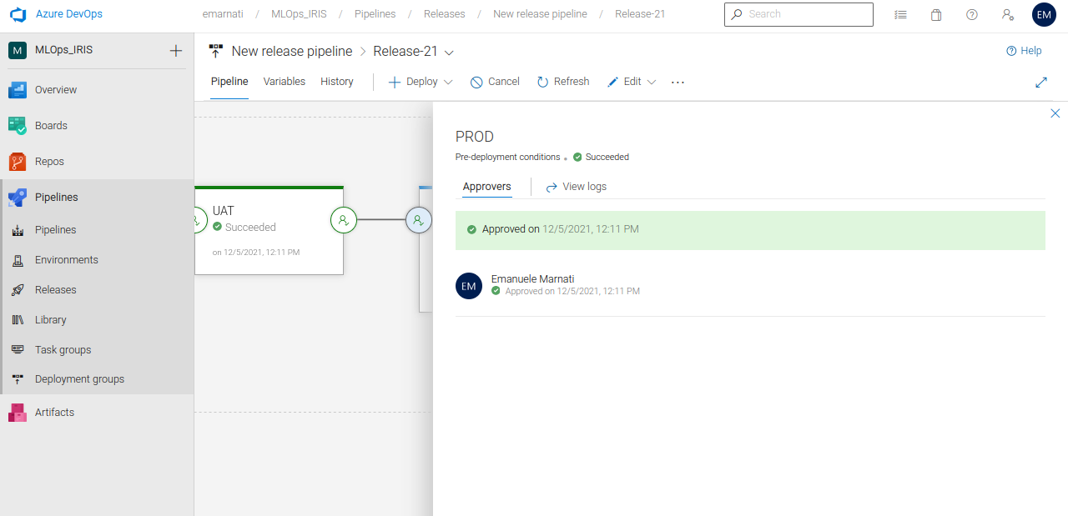
Multiplayer platform
Immediate Assessment
Users and management has Approved

Slide 44
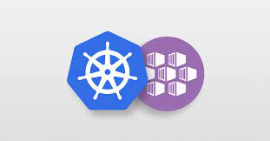

Real Time Continuous Data Ingestion
Azure Kubernetes Service
Data Drift integration (not with IRIS Dataset)
Data Quality Assessment
Integrated Learning
Continuous Learning
Conclusion and Further Improvements

Slide 45

Thanks for your Attention!
Check out the code and presentation on GitHub: https://github.com/emixstream/MLOps-On-Azure-

Slide 46
References & Bibliography
https://doi.org/10.1007/978-1-4842-6549-9
https://deepchecks.com/how-is-mlops-different-from-devops-a-detailed-comparison/
https://www.atlassian.com/devops/what-is-devops/agile-vs-devops
https://www.youtube.com/watch?v=ZVWg18AXXuE
https://www.youtube.com/watch?v=pLd7xF0z5Zs
https://github.com/srijiths/MLOps-IRIS
https://www.youtube.com/watch?v=1BSwYlJUxK0&list=PLZoTAELRMXVOk1pRcOCaG5xtXxgMalpIe

